Slide 1

MACHINE LEARNING PROJECT PRESENTATION
Contract Clause Extraction for
Operational Risk Review
Comparing sliding-window and TF-IDF retrieval with fine-tuned Legal-BERT on the CUAD dataset
Abhishek Gowda
Group: [TBD] | Course: Machine Learning | July 2026
Notes:
Introduce yourself and the project in one sentence. Keep intro under 30 seconds -- move straight to the problem.

Slide 2


The Problem
Manual contract review is slow and error-prone at scale
Contracts exceed the transformer's context window
Median CUAD contract length is 6,318 words (max 45,650), but a transformer like BERT can only process 512 tokens at once -- so every document must be chunked.
Reviewers search for a small set of recurring clauses
e.g. Termination Rights, Governing Law, Audit Rights, Cap on Liability -- 8 of CUAD's 41 labeled clause types.
Class imbalance makes false negatives costly
A missed (false negative) clause is far more costly than a false positive a reviewer can quickly dismiss -- so recall matters more than raw accuracy.
Notes:
Frame the problem: what question are we answering, and why does it matter operationally. This is not a generic download-data-train-model task.

Slide 3
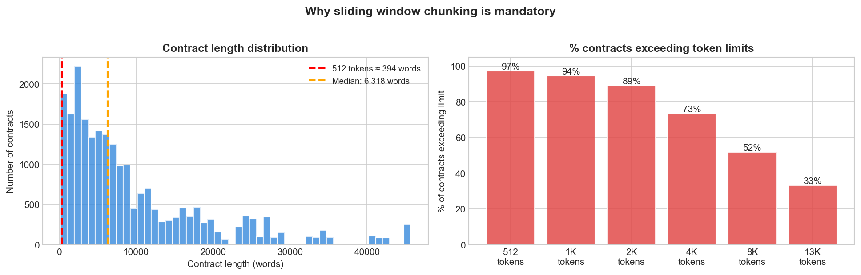
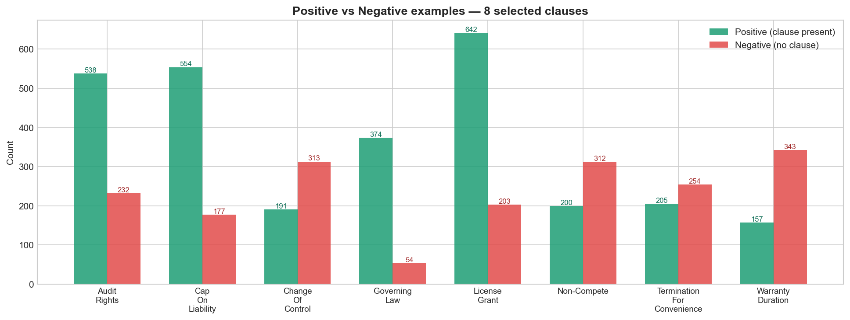
Dataset: CUAD
Contract Understanding Atticus Dataset -- 510 expert-annotated commercial contracts
408 / 102
41
97.2%
1 : 61
train / test contracts
clause types (8 selected)
of examples exceed 512 tokens
positive : negative chunk ratio
Notes:
Selected 8 clause types: Termination for Convenience, Governing Law, Audit Rights, Change of Control, Cap on Liability, License Grant, Non-Compete, Warranty Duration. Prevalence ranges 31%-87%. Long tail of contract lengths forces chunking.

Slide 4
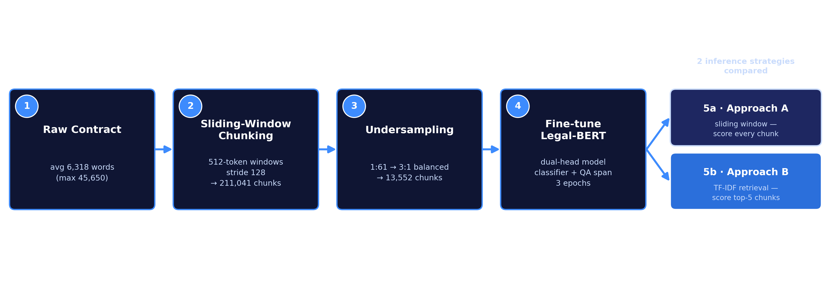
Methodology
From raw contracts to a balanced classification + span-extraction task
Raw ratio 1:61 (positive:negative chunks) -- undersampling brings training to 3:1, the test set is left untouched. Same fine-tuned Legal-BERT feeds both inference strategies -- only the chunk-selection method differs.
Notes:
Walk through the pipeline left to right. Emphasize the imbalance problem (1:61) and why undersampling only touches training data, never test data. Both approaches share the same fine-tuned model -- only chunk selection differs.

Slide 5

Models & Evaluation Criteria
Approach A -- Sliding Window
Approach B -- TF-IDF Retrieval
Every 512-token chunk is scored by the model (exhaustive scan)
Complete coverage, higher inference cost
Our baseline for comparison
TF-IDF cosine similarity ranks each contract's chunks against the clause query (a keyword-based relevance score)
Only the top-5 chunks reach the transformer
Cheaper inference; tests a retrieval hypothesis
Backbone model
Evaluation metrics
nlpaueb/legal-bert-base-uncased -- BERT pretrained on legal text. Fine-tuned with a dual head: binary classifier + QA span extractor, 3 epochs, lr 2e-5, batch 8, seed 42.
Classification: F1 and AUPR (area under precision-recall curve -- the main CUAD metric). Span extraction: Token F1 and Exact Match (EM). Same held-out test contracts for both approaches.
Notes:
Same backbone model for both approaches -- the only difference is which chunks reach the model at inference time. AUPR = area under the precision-recall curve, the metric CUAD's own paper uses; EM = exact match, standard for extractive QA.

Slide 6
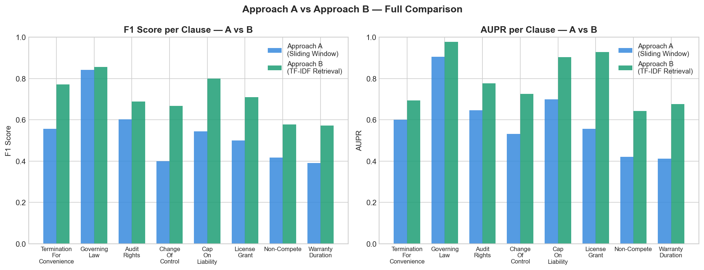
Results: Approach B Wins Every Clause
Test-set F1 by clause -- Approach A (sliding window) vs. Approach B (TF-IDF top-5)
Clause | Approach A (F1) | Approach B (F1)
Termination f. Conv. | 0.557 | 0.771
Governing Law | 0.842 | 0.855
Audit Rights | 0.602 | 0.689
Change of Control | 0.400 | 0.667
Cap on Liability | 0.543 | 0.800
License Grant | 0.500 | 0.709
Non-Compete | 0.418 | 0.578
Warranty Duration | 0.390 | 0.571
Mean | 0.531 | 0.705
+0.174
mean F1 gain, mean AUPR 0.596 -> 0.790
Notes:
Approach B wins on 8/8 clauses. Biggest gains on the hardest, lowest-prevalence clauses -- Change of Control and Non-Compete -- exactly where exhaustive scanning produces the most false positives.

Slide 7
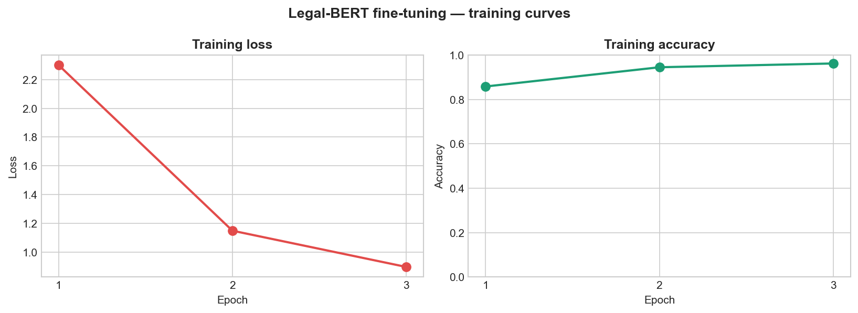

Span Extraction & Live Demo
Beyond "is the clause there" -- exactly which sentence(s) constitute it
0.491
0.119
303
Token F1
Exact Match (EM)
positive test contracts
Live demo contract: Governing Law
"It will be governed by the law of the People's Republic of China, otherwise it is governed by United Nations Convention on Contract for the International Sale of Goods."
Confidence: 0.997 (both approaches)
Approach A scored 7 chunks, Approach B only 5
Extracted spans match verbatim
Notes:
Run test_contract() live if time allows. Governing Law clauses are short and formulaic (highest EM); contrast with Non-Compete which is longer and more narrative.

Slide 8
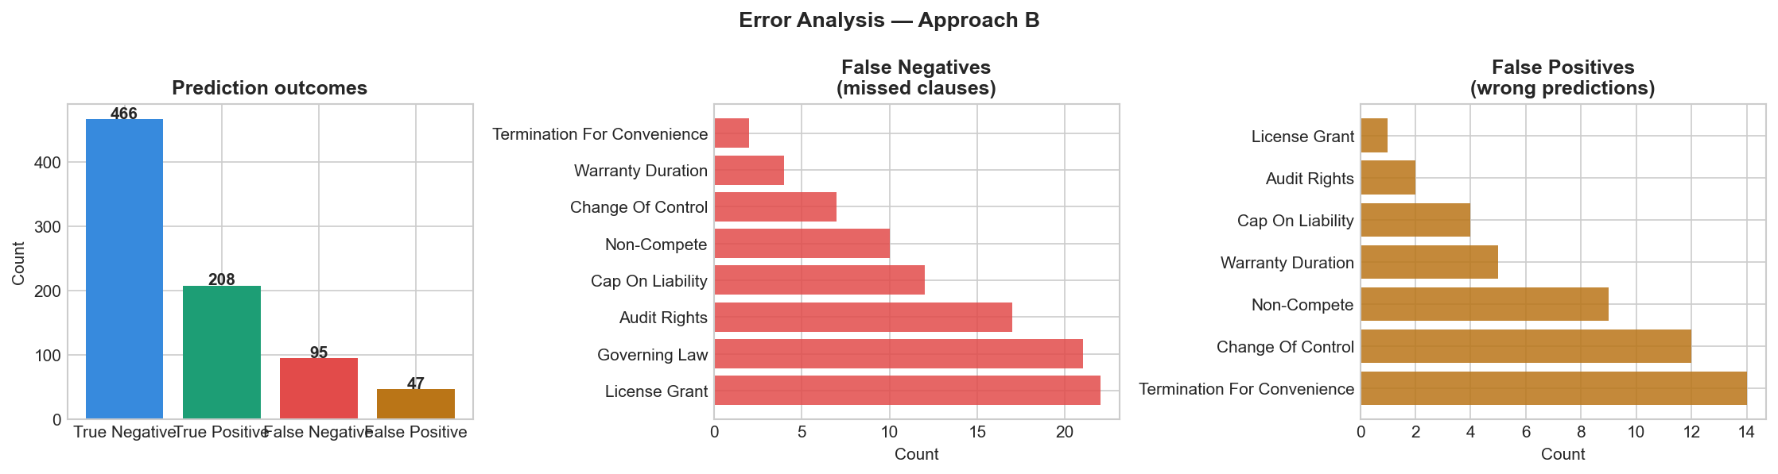

Error Analysis
Approach B, full 816-row test set -- where does the model still fail?
466
208
95
47
True Negatives (correctly said no clause)
True Positives (correctly found clause)
False Negatives (missed a real clause)
False Positives (flagged by mistake)
False negatives dominate -- and that's costly
TF-IDF retrieval misses clauses phrased with non-overlapping vocabulary (e.g. "inspection" vs. "audit") -- a lexical, not semantic, matching limitation
Clauses split across a chunk boundary have no single 512-token window containing the full answer
Notes:
95 false negatives vs 47 false positives -- system currently under-flags, which is the wrong direction for risk review. Root cause is lexical retrieval mismatch, not the classifier itself. The 3-epoch model is more precise than the 2-epoch version (fewer false positives) at a small recall cost.

Slide 9

Limitations & Conclusion
Limitations
Conclusion
Small per-clause test counts (10-83 positives) -- metrics carry variance
Only 3 fine-tuning epochs; train/test F1 gap (0.94 vs 0.57) still suggests some overfitting
TF-IDF is lexical, not semantic -- the identified bottleneck behind most misses
Only 8 of CUAD's 41 clause types studied
Retrieval-based chunk filtering beats exhaustive scanning on every clause tested -- without changing the underlying model.
Mean F1: 0.531 -> 0.705 | Mean AUPR: 0.596 -> 0.790
Gain comes from smarter candidate selection, not a stronger classifier
Directly relevant for deploying long-document extraction under compute limits
Notes:
Close by restating the core finding in one sentence and inviting Q&A. Be ready to justify: why TF-IDF over a learned retriever, why undersampling ratio 3:1, why only 3 epochs.

